Slide 1

Preparing audio data for analysis: transcription
SHAMINI NADARAJAN-BOARDMAN

Slide 2
ORTHOGRAPHIC TRANSCRIPTION AND THE MESSINESS OF LANGUAGE USE
There are many different styles of transcription, which suit different analytic methods.
We outline a style of audio transcription often called orthographic or verbatim.
This style, which focuses on transcribing spoken words (and other sounds) in recorded data, can be contrasted with audio transcription styles that include more phonetic or paralinguistic features,
Orthographic transcription records what was said. Even doing this form of transcription isn’t simple, as spoken language and written language are very different.
When we speak, we don’t use punctuation to make ourselves understood. We use pauses and intonation; we vary our speech in pace (faster, slower), volume (louder, quieter) and many other ways.
Spoken (natural) language is ‘messier’ than written language: we hesitate when we speak, we stumble over our words, start a word or phrase and don’t finish it, and say the same word or phrase a number of times.

Slide 3
UNDERSTANDING WHAT A TRANSCRIPT IS, AND WHAT IT IS NOT
Most qualitative analysis uses transcripts, rather than the original audio(visual) recording, so it’s important that your transcripts are thorough and of high quality
The transcriber, who listens to the recording, and makes choices about what to preserve, and how to represent what they hear.
A transcription notation system allows you to clearly and consistently translate spoken language into written language, meaning your approach to transcription is thorough and meticulous.

Slide 4
Appendix:
:::: lengthening of a sound
Becau- cut off, interruption of a sound
he says. Emphasis
= no silence at all between sounds
LOUD sounds
? rising intonation
(left hand on neck) body conduct
[notes, comments]
Transcription Conventions
(?) talk too obscure to transcribe.
Hhhhh audible out-breath
.hhh in-breath
[ overlapping talk begins
] overlapping talk ends
(.) silence, less than half a second
(..) silence, less than one second
(2.8) silence measured in 10^{ths} of a second
The meanings of utterances are profoundly shaped by the way in which something is said in addition to what is said.
Transcriptions need to be very detailed to capture features of talk such as emphasis, speed, tone of voice, timing and pauses but these elements can be crucial for interpreting data.

Slide 5
verbatim transcription
Dr 9: I would suggest yes paracetamol is a good symptomatic treatment, and you'll be fine
Pt K: fine, okay, well, thank you very much.
Representing (some) non-verbal features of the interaction on the transcript changes the interpretation of this two-line interaction (see Appendix, transcription conventions):
Dr 9: (..) I would suggest (..) yes paracetamol or ibuprofen is a good (..) symptomatic treatment (..) um (.) (slapping hands on thighs) and you’ll be fine
Pt K: fine (..) okay (.) well (..) (shrugging shoulders and laughing) thank you very much

Slide 6
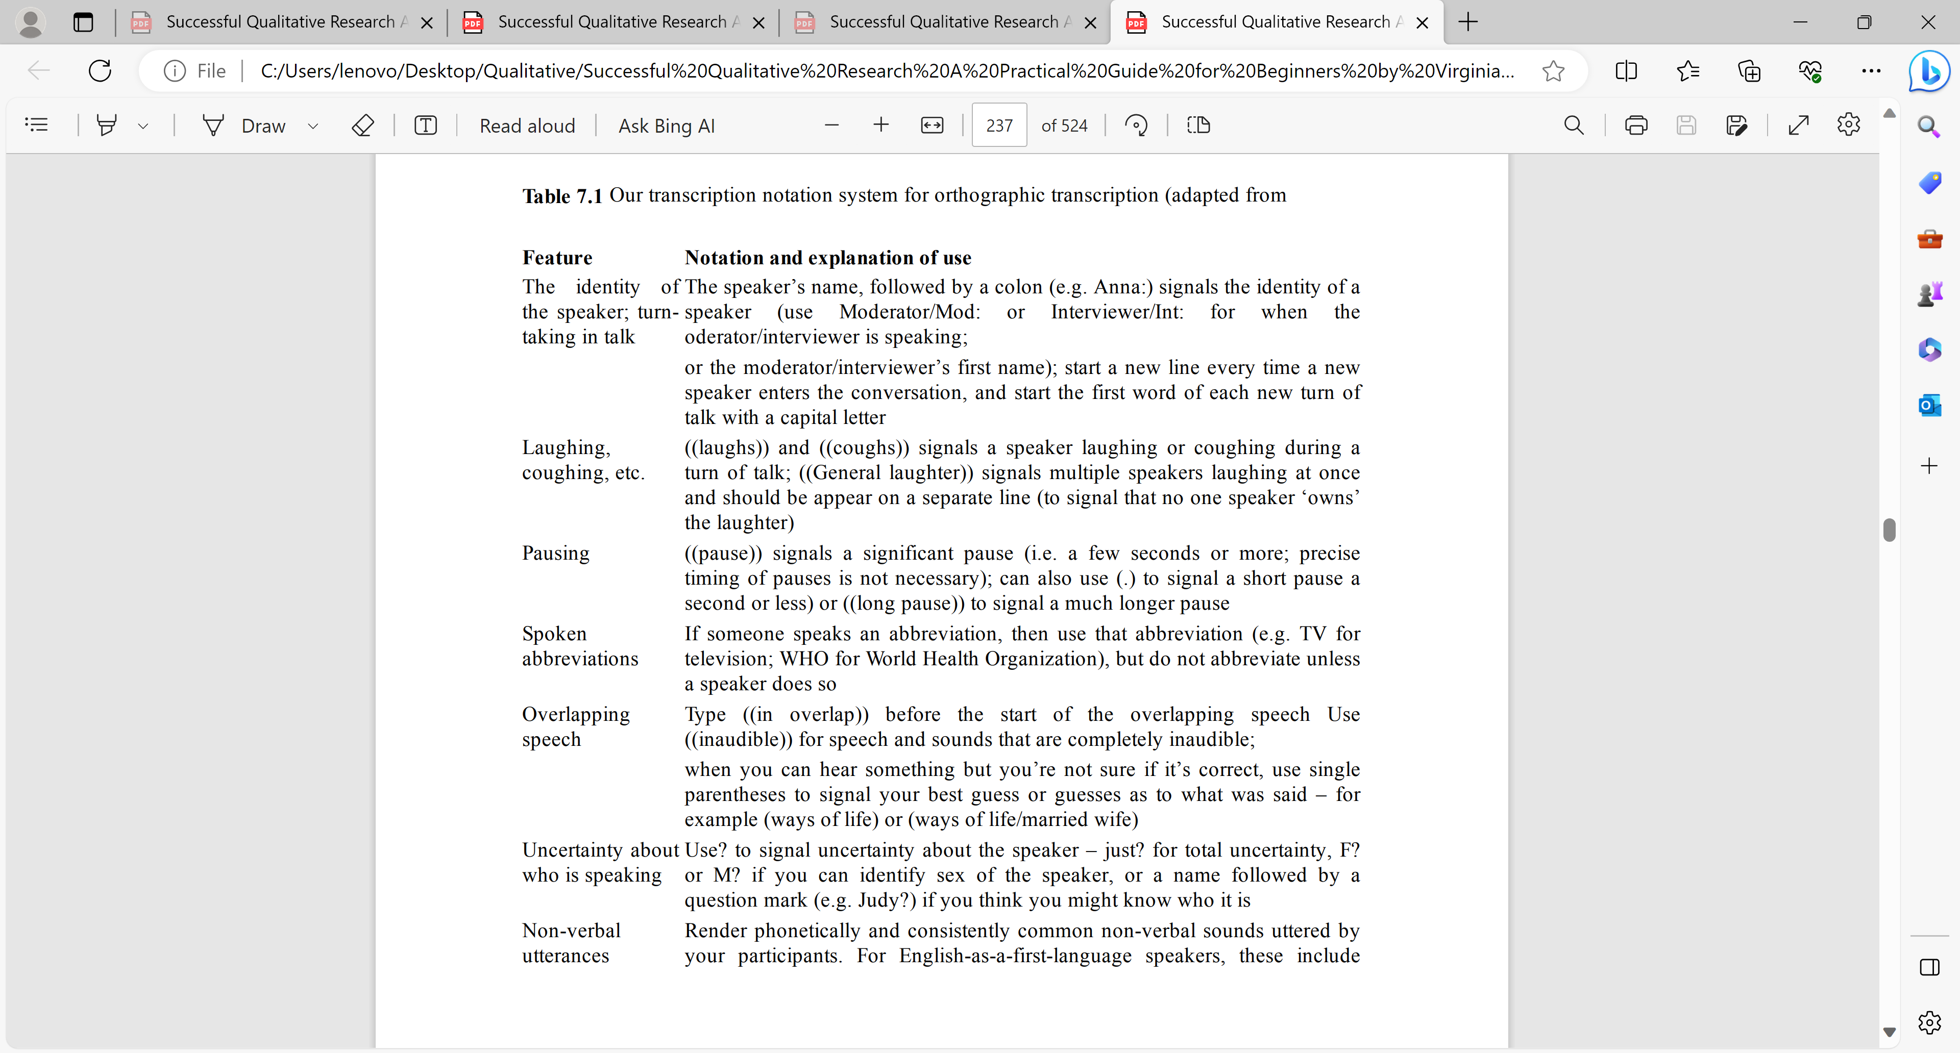







Slide 7





Slide 8
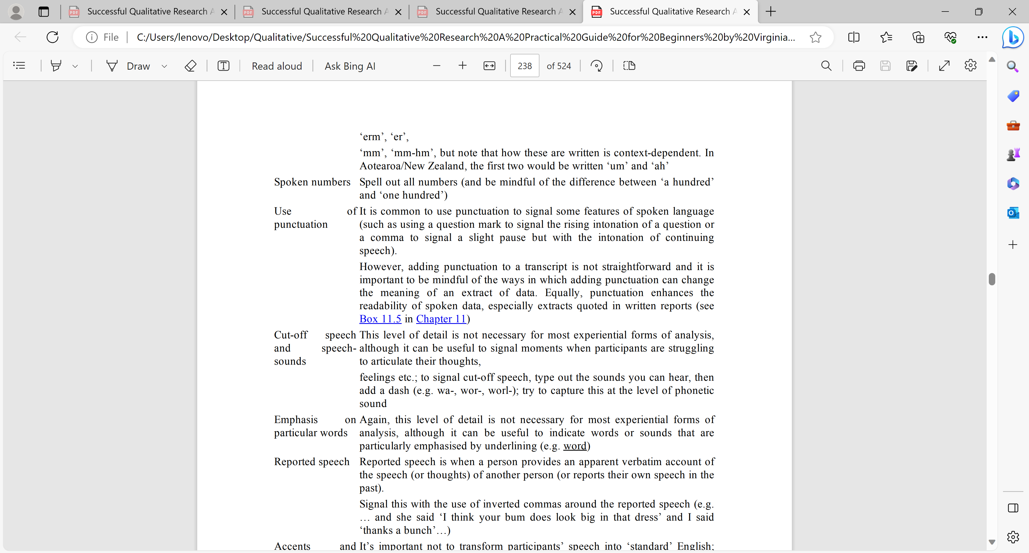




Slide 9







Slide 10
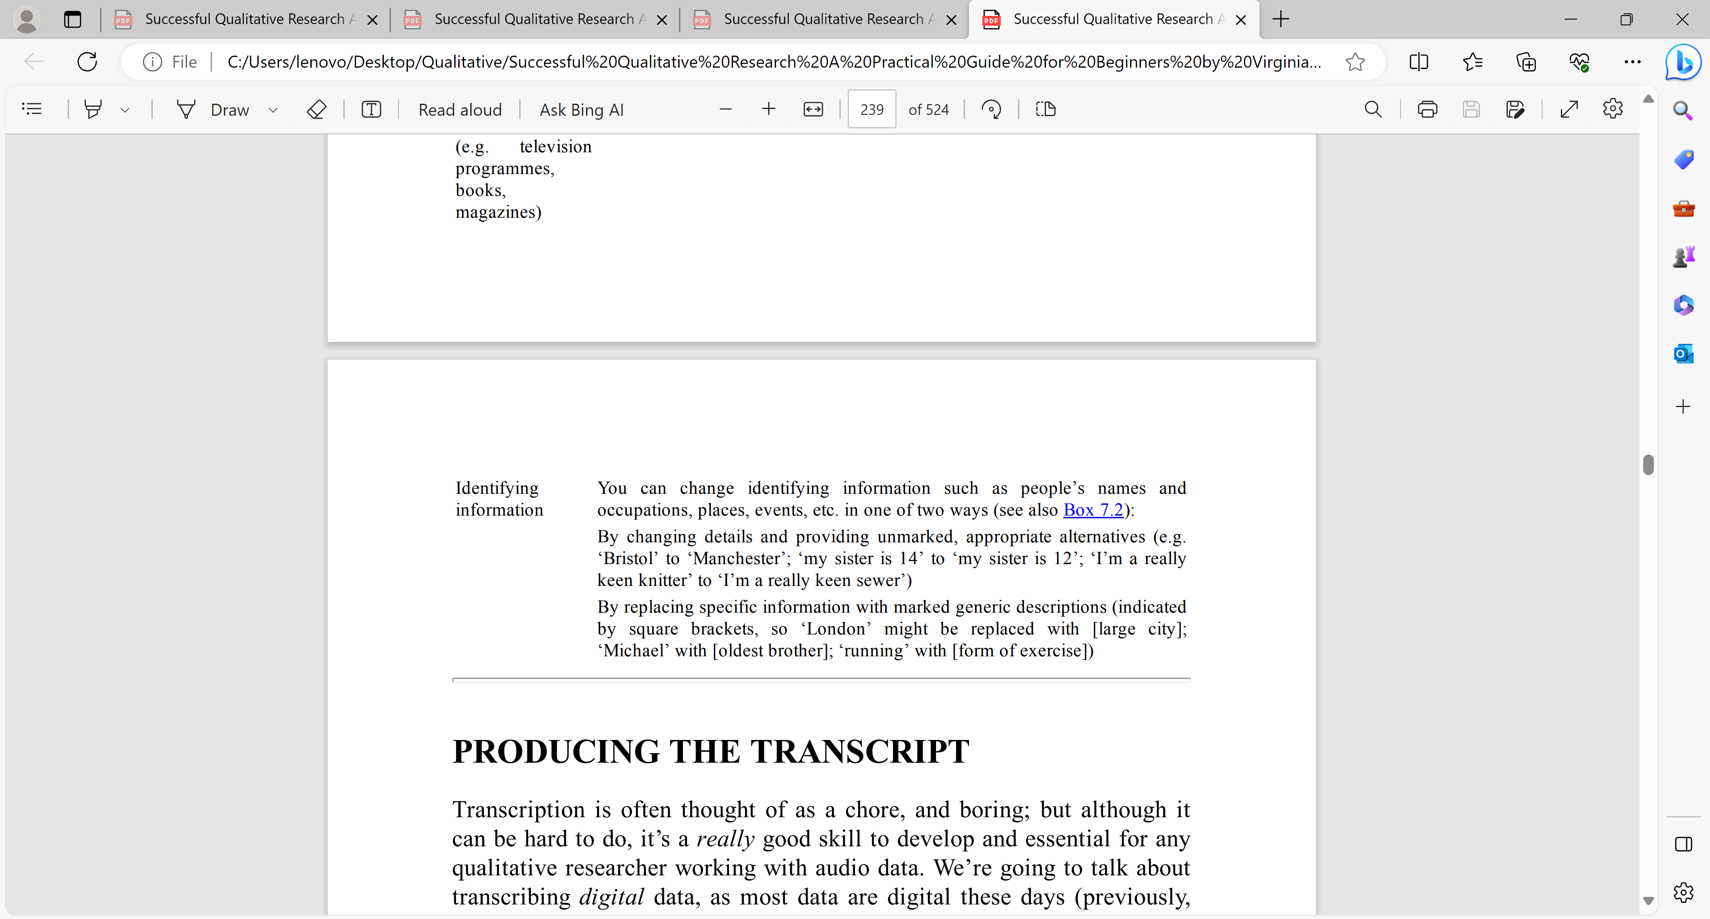






Slide 11
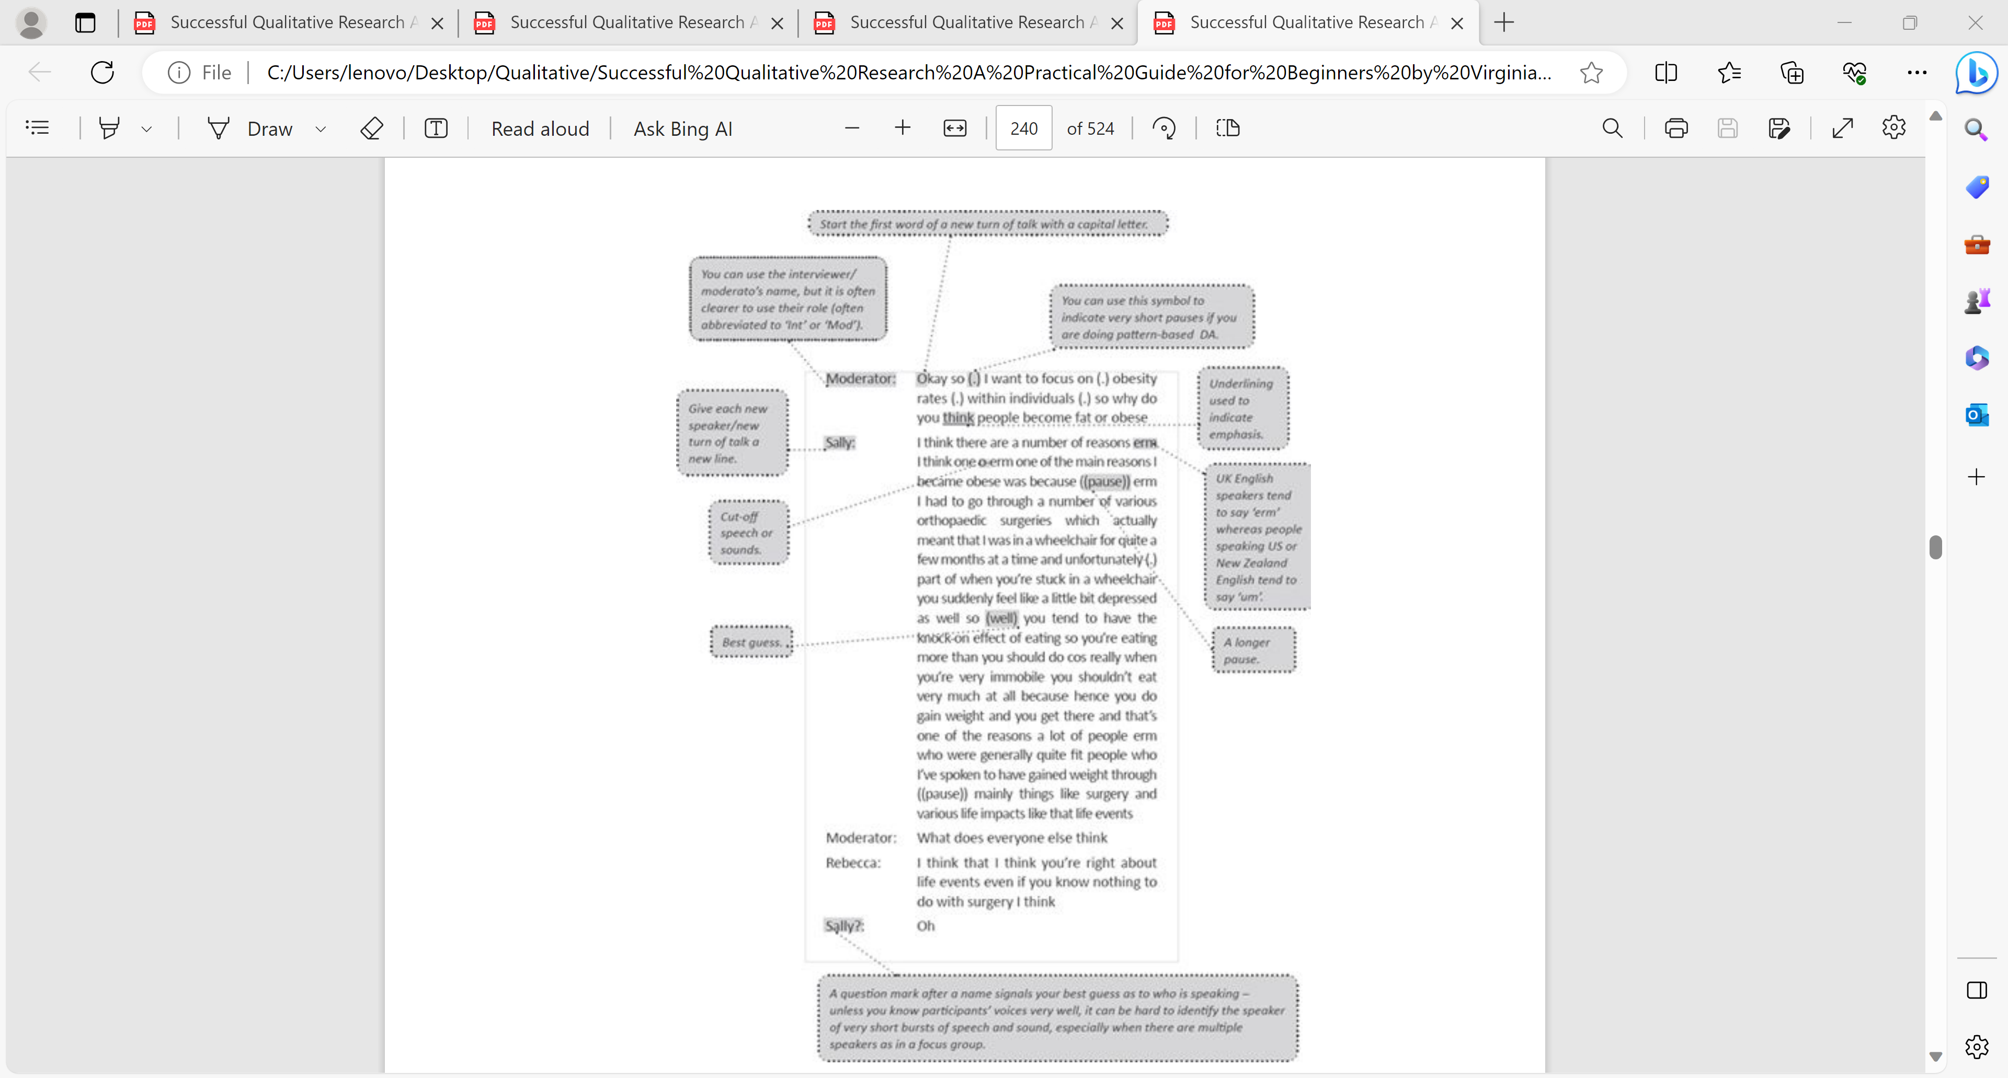




Slide 12
Decisions to make
Spoken language is structured and accomplished differently than written text, so when talk is re-presented as written text, it is not surprising that readers draw on their knowledge of written language to evaluate it.”
Other nonverbal cues, such as laughter, tone of voice (e.g. sarcasm, frustration, emphasis) and the use or omission of punctuation, can also drastically alter the meaning or intention of what an individual says.
The transcriber must make decisions about how much contextual information to include, such as interruptions, crosstalk and inaudible segments (Lapadat, 2000).
Because of the range of types of research that employ qualitative methods, there is no single set of rules for transcription but rather these decisions must be based on the research questions and approach.

Slide 13
Ethical or not?
Transcription is an inherently interpretative and political act, influenced by the transcriber’s own assumptions and biases (Jaffe, 2007).
Every choice that the transcriber makes therefore shapes how the research participant is portrayed and determines what knowledge or information is relevant and valuable and what is not.
Indeed, two transcribers may hear differently and select relevant spoken material differently (Stelma & Cameron, 2007).
As Davidson (2009) notes (and as I explore in further detail in the next section), despite being a highly interpretive process, transcription is frequently depicted using positivist
To Transcribe or Not to Transcribe?

Slide 14
Aim of orthographic transcription
to produce a thorough record of the words spoken.
sounds, hesitation, repetition, false-starts, pauses, laughter and so on are less important (they can be really time-consuming to transcribe).
How much of such detail you need relates to your analytic, methodological and theoretical positions.
An orthographic transcript is going to provide enough information to analyse data using the methods.
Experiential analytic methods, like interpretative phenomenological analysis, and some versions of thematic analysis (TA) and grounded theory (GT), focus on the words spoken by the participants – what was said rather than how it was said.
At most, the analysis might discuss moments when a participant cried, struggled to articulate themselves or was hesitant.
Critical analytic methods, like constructionist TA and GT, and pattern-based discourse approaches, are also interested in how things are said

Slide 15
To Transcribe or Not to Transcribe?
Most frequently be appropriate to employ a version of naturalized/intelligent verbatim, so that any participants’ quotes included in written works are more ‘readable’ and do not include excessive repetitions or verbal fillers such as ‘um’.
FREE ONLINE
https://transkriptor.com/?gad_source=1&gclid=CjwKCAjw7oeqBhBwEiwALyHLM2ZVgtiQx6rwhxQ2t4_jphKZps5e8MxcCg9zBTGvUot_l1mVKk6pwxoCGvYQAvD_BwE Express Scribe
https://otranscribe.com/ O transcribe
REV

Slide 16
ASSOCIATE PROF MELATI RECOMMENDATION
https://turboscribe.ai/?ref=gad-self-2023-11-28&gad_source=1&gclid=CjwKCAjw5v2wBhBrEiwAXDDoJbWf3aQbtnghIE9yIoxoszQfJ41NUW18yu1B-z4Fs0bw9RgDPV2mvxoC2g4QAvD_BwE

Slide 17
Online transcription: Examples
REV
https://www.youtube.com/watch?v=m9s_w3ND9GU
Sonix
https://www.cockatoo.com/?gad_source=2&gclid=CjwKCAjw7oeqBhBwEiwALyHLM6-paOBs0KJPg18wzKEYmCsyh7CI4B2psvEEWeNdwVCAx9M9Cm0c_xoCA1kQAvD_BwE
https://www.notta.ai/en/homepage?gad_source=2&gclid=CjwKCAjw7oeqBhBwEiwALyHLM3owgqnBRrvLOfeYeJpjNG8R2KkpoBj2gJj0ksNnWei9JKGlWtkxxhoChTsQAvD_BwE

